Slide 1
ALPHABET CLASSIFICATION WITH CNNs IN MATLAB

Slide 2
PROJECT OVERVIEW
Replacement of the last three layers of the pre-trained networks;
Choice of the best parameters for the training;
Classification of the hand-written capital letters;
Comparison of the performance and accuracy values of the networks.

Slide 3
THE NETWORKS
AlexNet
GoogLeNet
Inception-v3
ResNet-50
ResNet-101

Slide 4



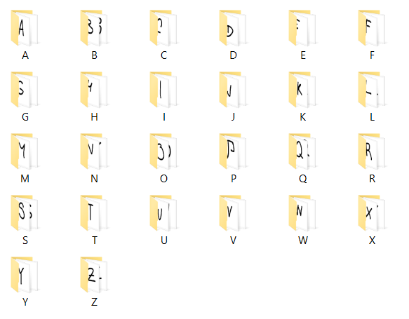
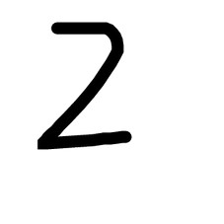





THE DATASET
https://github.com/GregVial/CoMNIST/tree/master/images

Slide 5
THE DATASET
At the beginning:
3000 images of handwritten capital letters divided in 26 folders (BipLab)
Merged with ‘Latin’ folder from:
https://github.com/GregVial/CoMNIST/tree/master/images
At the end:
13000 images

Slide 6
TRANSFER LEARNING: ALEXNET EXAMPLE
net = alexnet;
layersTransfer = net.Layers(1:end-3);
numClasses = numel(categories(imdsTrain.Labels))
layers = [
layersTransfer fullyConnectedLayer(numClasses,'WeightLearnRateFactor',20, 'BiasLearnRateFactor',20)
softmaxLayer
classificationLayer];

Slide 7
TRAINING OPTIONS
options =
trainingOptions('sgdm',...
'MiniBatchSize',64,...
'MaxEpochs',14,...
'InitialLearnRate',1e-3,...
'Shuffle','every-epoch',...
'Plots','training-progress',...
'ValidationData',imdsValidation,...
'ValidationFrequency',32, ...
'VerboseFrequency', 32,...
'ValidationPatience',Inf, ...
'ExecutionEnvironment','gpu');

Slide 8
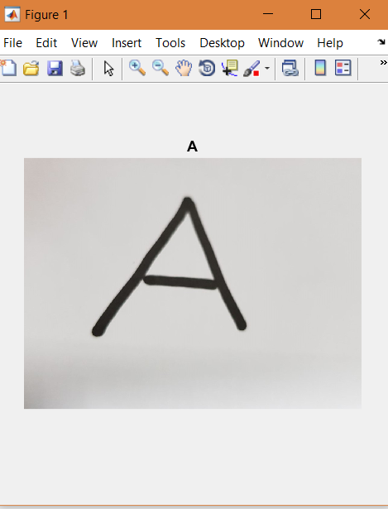
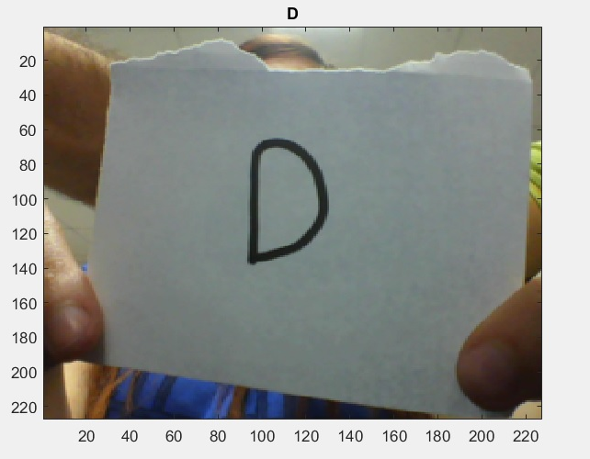
TRAINING & CLASSIFICATION
[netTransfer, infoTraining] = trainNetwork(imdsTrain,layers,options);
[YPred,scores] = classify(netTransfer,imdsPrediction);

Slide 9
